Slide 6
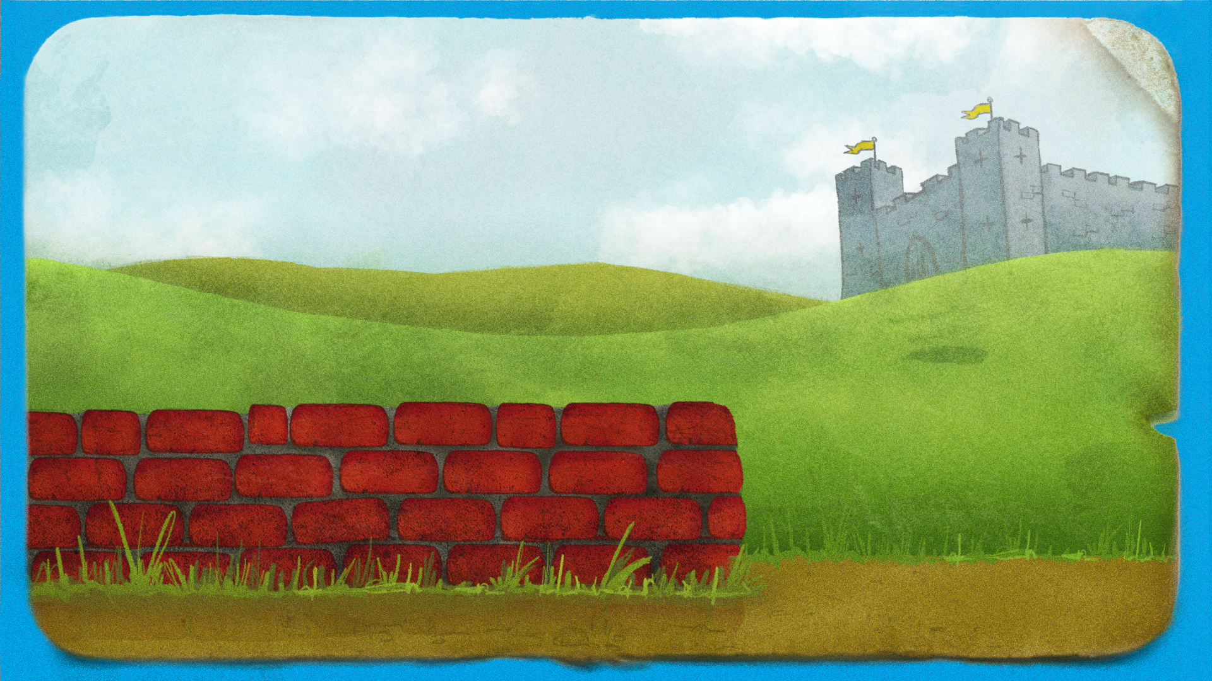
Notes:
Teachers’ notes:
Q. Does anyone know who this character is?
See if pupils recognise Humpty Dumpty and then begin to read through the nursery rhyme.

Slide 7
Notes:
Teachers’ notes:
Read through the nursery rhyme with pupils.

Slide 8
Notes:
Teachers’ notes:
Read through the nursery rhyme with pupils.

Slide 9
Notes:
Teachers’ notes:
Once you have read through the nursery rhyme, ask pupils:
Q. Can you explain what happened to Humpty Dumpty? Why did he break?
Eggs usually break if you drop them on a hard surface.
Q. Would he have broken if he fell onto a carpet or a duvet? Why / why not?
He might not have broken because a carpet or a duvet is softer than the floor.
Q. Would he have broken if the wall was lower?
Maybe not! If we drop an object from a lower height it will be travelling more slowly when it hits the ground.
This is because it doesn’t fall for as long – so it has less time to pick up its speed.
If the wall Humpty fell from were lower, he would be falling at a slower speed. That means he might not break!
Q. Have you ever dropped something and broken it? What was it made of? What surface did it land on? How high up was it when you dropped it?
Allow children time to share their experiences with one another.

Slide 10
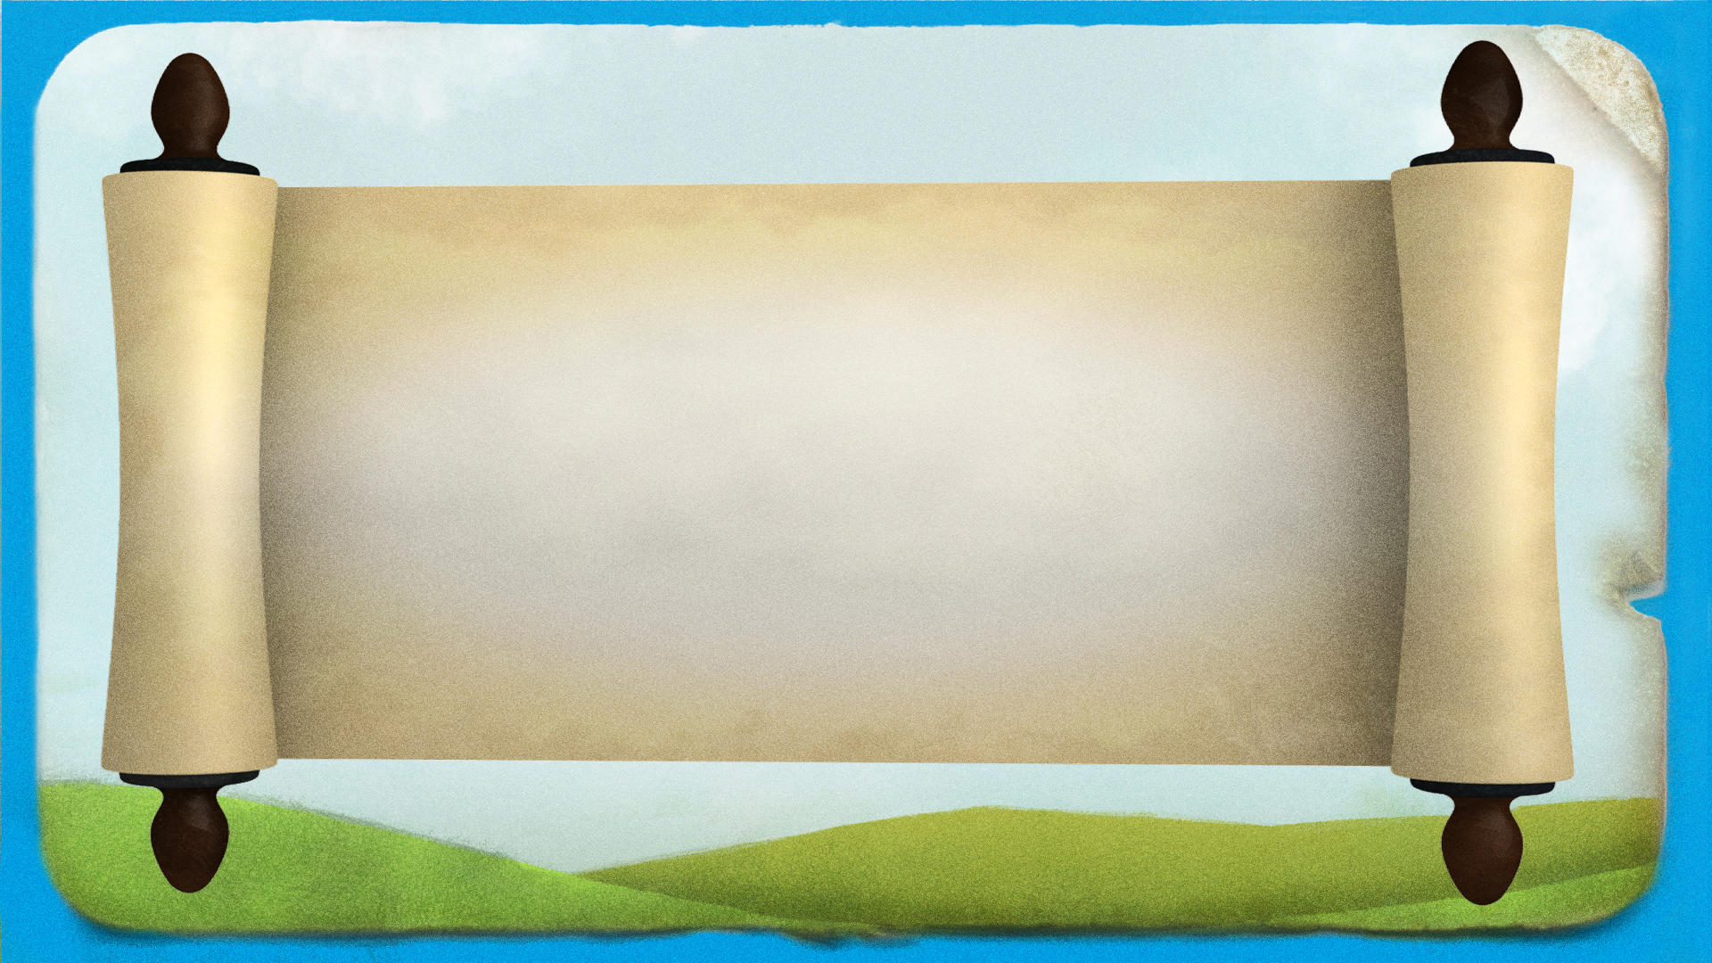
Notes:
Teachers’ notes:
You could print this slide and leave it on the teacher’s desk as though Humpty has sent the pupils a letter asking for their help.

Slide 11
Notes:
Teachers’ notes:
Q. How could we stop Humpty from breaking?
To get pupils up and moving, they could act out or freeze frame what would have happened to Humpty if he had one of the items shown in the pictures above to protect him.
Q. How would the story change if Humpty had had one of the things shown above?
For example, Humpty wouldn’t have broken if he were wearing a parachute
Q. What are the problems with each? For instance if Humpty wants to sit on different walls he won’t want to carry a crash mat with him. How would he attach his parachute to himself? What would he attach his bungee jumping cord to? If he wore a helmet on his head, how would this protect the rest of him?

Slide 12
Notes:
Teachers’ notes:
Note that the success criteria above get progressively more difficult.

Slide 13
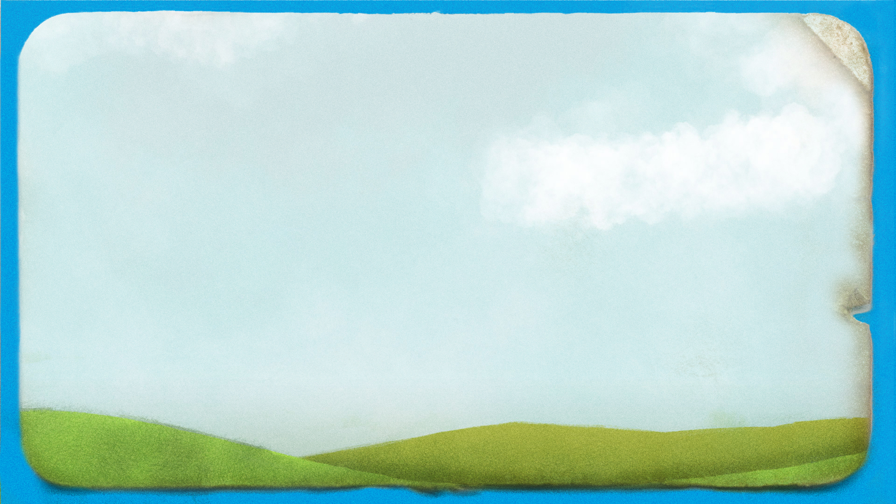
Notes:
Teachers’ notes:
Q. What objects can you see around Humpty?
- Chair
- Toy building bricks
- Scarf
- Magnifying glass
- Rock
Explain that a material is what an object is made from.
Q. What material is each object made from?
- Wooden chair
- Plastic toy building bricks
- Cotton/fabric/wool scarf
- Glass magnifying glass.
- The rock is made from rock! Rock is different because it is natural rather than manmade.
Q. What other materials can you see around you?
Answers might include brick, leather, stone, paper.
Q. Now, look at these describing words on the board. Can you spot something in the picture that we could describe with each word?
NB: Remind pupils that flexible means bendy and inflexible means not bendy, and that transparent means see through!
Answers might include that:
wood is hard and inflexible (and smooth when made into a chair)
plastic is smooth and waterproof
cotton/fabric/wool is flexible and soft
glass is transparent, waterproof, hard and smooth
rock is hard, waterproof, inflexible and rough.
Explain that the describing words that they have chosen for each material are its properties. We can use our senses – touch and sight – to find the properties of each material.
Q. Could you make the objects out of other materials? Would cotton make a good window? Would wood make a good piece of jewellery? Not always – cotton isn’t hard, so it wouldn’t make a good chair. Rock is rough, so it wouldn’t make a comfortable scarf.
Q. Feel your school jumper – what are its properties? It is soft, flexible/bendy, and dull not shiny.
Explain that to help Humpty, they will need to know about the properties of materials.

Slide 14
Notes:
Teachers’ notes:
Q. Have you ever worn clothing like this to protect yourself?
Allow pupils time to share their experiences with one another.
Q. Which materials do you think they use?
- Helmets and knee pads use hard plastic.
- Sun hats use flexible, breathable fabric
- Sunglasses use dark plastic or glass that is translucent/see through and dark
- Raincoats and wellies use flexible, waterproof fabric.
Q. Why do you think we wear protective clothing on these parts of our bodies and not others?
- Helmets protect our heads, as brain injuries can be very serious.
- Knee and elbow pads are useful as these parts of us stick out, so they’re more likely to get scraped.
- Sun hats protect the backs of our necks from the sun so our skin doesn’t get burnt. We can get sunstroke if our heads get too hot.
- Sunglasses protect our eyes, as they can get damaged by bright light.
- Raincoats and wellies protect most of us, but not our faces, as we need to be able to see and breathe easily, and not hands, as it is useful to have them free to do things.

Slide 15
Notes:
Teachers’ notes:
Q. Are eggs like Humpty strong?
Pupils may say no, as he breaks when he falls. But actually eggs are stronger than you’d think – they are designed for birds to sit on them after all!
Q. What will happen to this egg if I squeeze it hard in my palm?
Pupils share their ideas.
Demonstration
Seal an egg in a plastic sandwich bag. Demonstrate squeezing it with the palm of your hand (or get a pupil to demonstrate this). Just make sure you apply pressure to the entire egg. Explain that it is difficult to break an egg by squeezing it in this way!

Slide 16
Notes:
Teachers’ notes:
Q. Why didn’t the egg break?
Eggs have a strong shape – they need to have this special strong shape because mother birds sit on them to keep them warm! Even if you stand on a box of eggs, they won’t break!
Arches have a similar shape – you can put a lot of weight on top of them, but it all spreads out evenly along the arch and the arch does not collapse.
Q. Why does Humpty break when he falls off the wall then?
If the weight is spread out across the whole egg shell it won’t break. However if there’s lots of weight or force on one bit of the egg, then it can break easily.
Demonstration
Seal an egg in a plastic sandwich bag. If you drop it from a height of at least 1 metre, it will usually break – a little bit of the egg hits the ground really hard.

Slide 17
Notes:
Teachers’ notes:
Q. Which material do you predict will protect Humpty best when he falls?
Pupils share their ideas.
Extension Q: How could pupils change the materials to make them work better?
Answers might include screwing up tissue paper or silver foil to make it thicker instead of using thin layers, or sticking the lolly sticks into a different shape.

Slide 18
Notes:
Teachers’ notes:
Q. Why do you think that material will help protect Humpty from his fall?
Encourage pupils to describe the properties of their chosen material in their answer e.g. I predict the bubble wrap will be best because it is soft, thick and smooth.
Pupils can write a sentence explaining their prediction.

Slide 19
Notes:
Teachers’ notes:
Explain that to avoid wasting eggs (or hurting Humpty!) we are going to use practice eggs before we use a real one (see slide 4 for practice egg options).
Demonstration
Show pupils what will happen to their practice egg if it has no protection, by dropping it onto the floor. The practice egg will break apart.
Instructions:
Run through how to do an egg drop experiment, working in pairs:
1. Place four layers of the test material in the bottom of an open sandwich bag.
2. Put a practice egg in the bag.
3. Drop the bag.
4. Observe what has happened to the practice egg.
Q. What will need to stay the same to make sure our test is fair?
Explain to pupils that before we start our test, we need to make sure it is ‘fair’.
A fair test means we only change one thing – the material we use!
Answers on next slide.

Slide 20
Notes:
Teachers’ notes:
Q. How can you make a fair test?
Take answers from pupils and then run through the points on the board.
Practical experiment – practice eggs
Allow pupils time to complete the experiment for each different material they are testing using the practice egg.
Practical experiment – real eggs
Once they have made a decision about the best material, they will use this material with a real egg.
Explain to pupils that Humpty Dumpty (the real egg) is more delicate than our practice egg, so we are going to need to help him by using more of our chosen material and dropping him from a lower height.
1. Pupils should fill a sandwich bag halfway with their chosen material.
2. Place a real egg on the topmost layer (they may want to draw Humpty’s smiling face on before the drop).
3. This time, make sure they seal the sandwich bag and drop the egg from a slightly lower height that with the practice egg (less than 1 metre).
Q. What happens to their egg? Did they choose the right material?
Pupils share their findings.
SAFETY: Make sure that pupils don’t touch any raw egg if it spills out of their bag. If they do come into contact with raw egg, make sure that they wash their hands immediately.

Slide 21
Notes:
Teachers’ notes:
Q. Can you list the materials you used?
Pupils share their findings.
Q. Which of them were good for protection?
Pupils share their findings. The softer, thicker materials will have worked best.
Q. Were their predictions correct?
Pupils share their findings.

Slide 22
Notes:
Teachers’ notes:
Encourage pupils to discuss why they think certain materials gave the best protection – prompting them to use the key words of the board to describe its properties.
For example, you might ask:
Q. Which of these words could we use to describe that material?
Q. Do you think flexible or inflexible / hard or smooth / thick or thin / rough or smooth materials give better protection?

Slide 23
Notes:
Teachers’ notes:
You may wish to print this slide for pupils. Pupils can draw their chosen protective material and write a sentence to explain which material they chose and why.

Slide 24
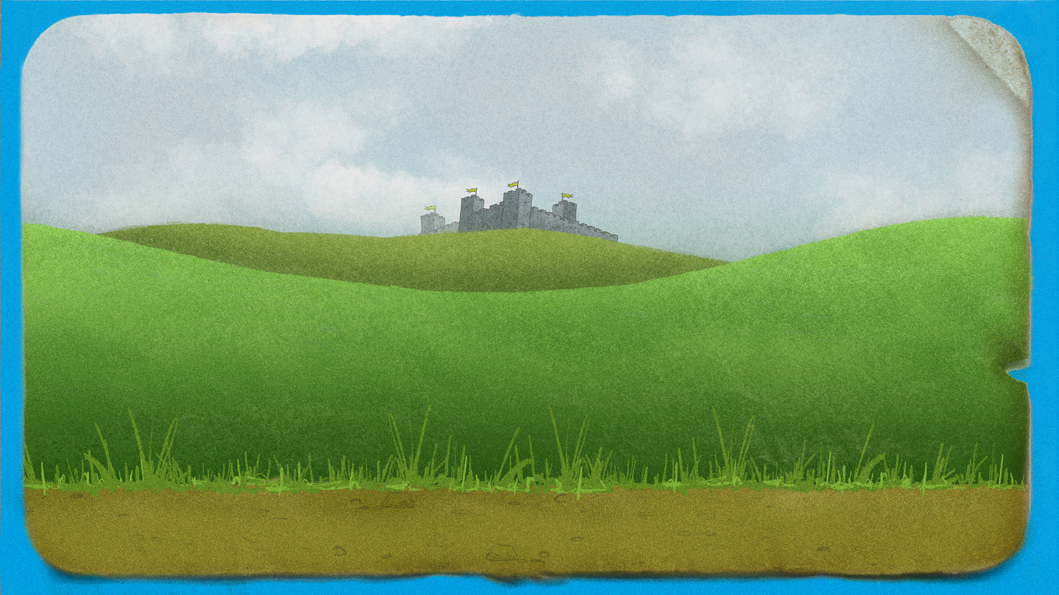
Notes:
Teachers’ notes:
Q. Which material could each of the King’s men be offering to make a suit for Humpty?
There will be a number of correct answers. A hard inflexible material could be glass, metal, wood or hard plastic. A smooth, soft material could be fabric, foam, bubble wrap or a duvet.
Q. Which of the king’s men has the best material to protect Humpty? Why?
Again, there is more than one correct answer, but a smooth soft material would be more flexible, so would probably work better for a suit, and be better at absorbing the impact.

Slide 25
Notes:
Teachers’ notes:
Q. Which bricks make the sentence correct?
The answers could be shiny and hard.
Q. What other words, not on the board, could complete our sentence?
e.g. opaque, waterproof, inflexible.

Slide 26
Notes:
Teachers’ notes:
Q. Which brick makes the sentence correct?
Answers could be cotton, fabric or plastic.
Q. What other words, not on the board, could complete our sentence?
Answers could include paper or rubber.

Slide 27
Notes:
Teachers’ notes:
The following 3 slides contain possible extension activities to be used with pupils in the classroom or in a STEM club.
To make Humpty bounce:
By soaking eggs in vinegar for a couple of days, pupils will be able to remove the eggs’ brittle shells. However, the membrane will remain. This membrane will keep the egg together and make it so that it ‘bounces’ when dropped from a low height. At what height can these shell-less eggs be dropped from without breaking?
Equipment
Eggs
Vinegar
Bowls
Height chart
Measuring stick
Cleaning materials (at least some eggs will break).
Time
2 days to soak the eggs, 45-60 mins to do the activity.
Curriculum link (England)
Science – Everyday materials
- Find out how the shapes of solid objects made from some materials can be changed.

Slide 28
Notes:
Teachers’ notes:
Build the tallest wall possible for Humpty to sit on. Using equipment you have in your classroom, or outside in your school’s playground, task pupils with building the tallest wall. Help pupils consider the best materials to use and to think about why they are suitable for this activity.

Slide 29
Notes:
Teachers’ notes:
For a STEM club version of the activity:
Focus on a more broad approach to protecting Humpty using the ideas on this slide 10 for creative inspiration.
Which method will pupils choose to protect Humpty?
The photographs on this slide could also serve as a starting point for pupils. For example, they could use air resistance to create an egg parachute (top right) or use elastic materials like tights of elastic bands to create a bungee jump (bottom right).
Pupils could compete to see whose egg best survives the drop with their chosen method of protection.
Tips
‘Test’ eggs can be used prior to the actual egg drop – options for ‘test’ eggs can be found on slide 4.

